Slide 1
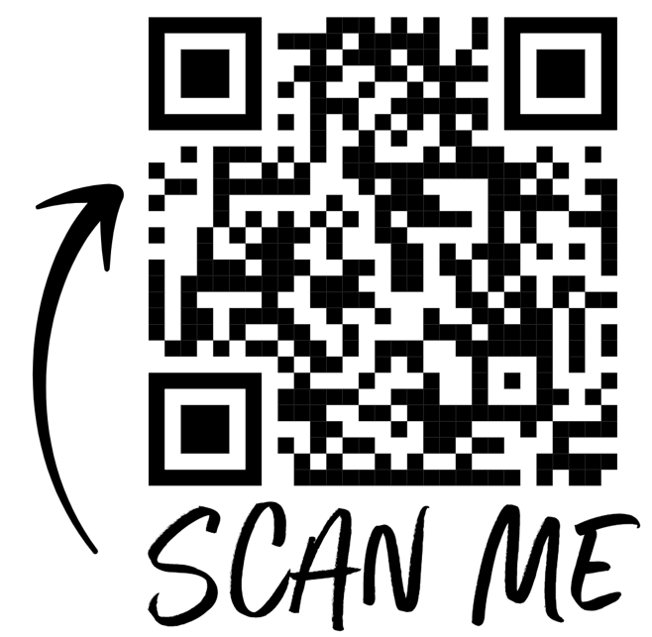
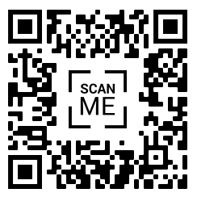
PCYC PARKES OOSH DEC 2022
MONDAY 19TH DEC
Baubles, mini wreaths and reindeers
Kicking off the first week of holidays were making awesome Christmas tree decorations!
Baubles, mini wreaths and layered reindeers will be on offer for the children to pick from.
For some crazy cooking we will be making reindeer bark.
Make sure to bring
Drink bottles
Morning tea, lunch, afternoon tea
Enclosed shoes
TUESDAY 20TH DEC
Explosion photo gift box
It’s the gift that keeps on giving! Today we’ll be making Explosion Photo Gift Boxes for children to take home as Christmas presents.
Please make sure to bring in plenty of photos!
These will be cut up, so photo copies are recommended!
Make sure to bring
Enclosed shoes
Drink bottles
Morning tea, lunch, afternoon tea
Photos from home
WEDNESDAY 21ST DEC
Xmas shrinky dink plastics
Back by popular demand is shrink plastics with a Christmas theme!
These can be used as Christmas tree ornament, key rings or attach a magnet and stick to your fridge!
We will also be making Christmas bark for arvo tea and to take home.
Make sure to bring
Enclosed shoes
Drink bottles
Morning tea, lunch, afternoon tea
THURSDAY 22ND DEC
Movie Day and Felt Christmas Stockings
Using felt we will be making awesome personalized Christmas stockings to take home.
After lunch we will settle in with popcorn and a milkshake to enjoy a PG Christmas movie
Make sure to bring
Drink bottles
Morning tea, lunch, afternoon tea
Enclosed shoes
FRIDAY 23RD DEC
CLOSED
We will be closed for the Christmas and New Years Period.
We hope everyone has a lovely and restful break and look forward to seeing everyone in the new year.
Vacation Care will return Tuesday 3rd January 2023.
EARLY BIRD $65 NORMAL $70
Early Bird $65 Normal $70
Early Bird $60 Normal $65
Early Bird $60 Normal $65
Early Bird $65 Normal $70
parkesoosh@pcycnsw.org.au
Phone: 0491 693 444
Advertised fees are full price, CCS reduced fees are available for eligible families.
We accept BASC Vouchers
< Current Families
Or use your App
New
Family
Enrolment >

Slide 2
PCYC PARKES OOSH JAN 2023
MONDAY 2ND JAN
PUBLIC HOLIDAY
TUESDAY 3RD JAN
Raptor Reptiles
Kicking off 2023 we have a reptile show coming to Parkes PCYC!
We will get up close and personal with a variety of scaly reptiles and learn more about them!
We will also be holding a Lego comp for who can make the best Lego reptile to show the Reptile Man in the afternoon.
Prizes to be won!
Make sure to bring
Drink bottles
Morning tea, lunch, afternoon tea
Enclosed shoes
WEDNESDAY 4TH JAN
Colour Me Bucket Hats
Who doesn’t love to decorate and DIY?!
We will be decorating our own bucket hats that will be used for Vacation Care.
We will show off our finished hats outside and put them to use on the outdoor equipment!
Who will win todays Lego comp of best Lego boat?
Make sure to bring
Drink bottles
Morning tea, lunch, afternoon tea
Enclosed shoes
THURSDAY 5TH JAN
Sensory Day
Play dough, slime, shaving cream clouds and oobleck are some of the fun sensory workshops on offer for today.
Which ones will you choose to get your hands dirty with?! Will paint or food colouring make the best colours?
Make sure to bring
Water bottles
Morning tea, lunch, afternoon tea
Enclosed shoes
FRIDAY 6TH JAN
DIY Wooden Hanging Calendars
Just in time for the start of 2023 we are making wooden hanging calendars for children to decorate and assemble.
Feel free to bring in a photo or two to customize your calendar with!
Who will be todays Lego comp winner of...Lego Octopus?
Make sure to bring
Water bottles
Morning tea, lunch, afternoon tea
Enclosed shoes
Early Bird $73 Normal $78
Early Bird $67 Normal $72
Early Bird $70 Normal $75
Early Bird $65 Normal $70
Places are filling fast,
BOOK EARLY so you don’t miss out.
Book by 3rd December to access Early Bird prices.

Slide 3
PCYC PARKES OOSH JAN 2023
MONDAY 9TH JAN
BYO Wheels Day
.
Vroom, Vroom!
Bring your bike, scooter, skateboard or roller skates for BYO Wheels day at PCYC.
Make sure to bring your helmet and other safety gear to ride! Helmets are essential!!
Alternative activities will be painting, iron beads and Lego comp of best plane.
Make sure to bring
Drink bottles
Morning tea, lunch, afternoon tea
Enclosed shoes
TUESDAY 10TH JAN
Art Day
Salt snowflakes, string pull flowers, marbling and shaving foam painting are the methods we will be experimenting with today.
Using marbles and nail polish we will try 2 different methods of painting and marble dipping photo frames.
Make sure to bring
Enclosed shoes
Drink bottles
Morning tea, lunch, afternoon tea
WEDNESDAY 11TH JAN
Crazy Cooking
Book in for the opportunity to get messy in the kitchen creating rocky road cups, cookies and hot dogs for lunch!
Today’s cookie options include choc chip, smarties and sprinkles. We will be having these for arvo tea.
Make sure to bring
Enclosed shoes
Drink bottles
Morning tea, lunch, afternoon tea, alternative lunch if needed
THURSDAY 12TH DEC
The Master of Slime
Let the Master of Slime guide you through the slime making process to create the perfect slime.
This interactive and hands on workshop is super fun-filled where kids will experiment, mix and create their very own special blend of slime AND the best part – kids will be able to take home their goop masterpiece!
Make sure to bring
Drink bottles
Morning tea, lunch, afternoon tea
Enclosed shoes
FRIDAY 13TH JAN
Super Silent Dance Party
A high energy dance party without the Noise! Move and groove to the best ever rocking playlist. Kids will be provided with a set of high quality sounding wireless headphones.
With two music channels available there is something for everyone.
Our two Dj’s will battle it out with two different styles of music and include games, magic, comedy, circus, competitions and even a little education!
Make sure to bring
Drink bottles
Enclosed shoes
Morning tea, lunch, afternoon tea
EARLY BIRD $65 NORMAL $70
Early Bird $60 Normal $65
Early Bird $65 Normal $70
Early Bird $65 Normal $70
Early Bird $73 Normal $78
Early Bird $73 Normal $78
parkesoosh@pcycnsw.org.au
Phone: 0491 693 444
Advertised fees are full price, CCS reduced fees are available for eligible families.
We accept BASC Vouchers
< Current Families
Or use your App
New
Family
Enrolment >

Slide 4
PCYC PARKES OOSH JAN 2023
MONDAY 16TH JAN
DIY Magnets and Plaster of Paris
Todays workshop includes DIY magnets made with plaster of Paris. These would make a great addition to any space with cool and funky plaster designs.
Also on offer today is painting to build on last weeks painting methods.
Make sure to bring
Drink bottles
Morning tea, lunch, afternoon tea
Enclosed shoes
TUESDAY 17TH JAN
Bubble Blue
Bubbles will come from everywhere in this hilarious spectacle!
BubbleBLUE will blow you away with a magical demonstration of bubbles using shapes, smoke and momentum.
After the show, it’s participation time, when BubbleBLUE will give everybody the chance to get inside a giant bubble, before she takes everyone outside to learn how to make bubbles of their own!
Make sure to bring
Drink bottles
Morning tea, lunch, afternoon tea
Enclosed shoes
WEDNESDAY 18TH JAN
Minute to Win It Day
Book in to compete in todays crazy challenges of fun, skills, coordination and teamwork to win some awesome prizes!
Cup Stack, Keep Em Up, Tower Test, Ball Drop, Junk in your Trunk and Ping Pong Eggs are just some of todays group challenges to be done.
Make sure to bring
Drink bottles
Morning tea, lunch, afternoon tea
Enclosed shoes
THURSDAY 19TH JAN
Tie Dye
Always a fan favourite is tie dye! Today’s tie dye pack includes steps on how to make a variety of different designs and patterns.
Who will make the coolest tie dye shirt?!
Prizes for the drawing comp: your favourite animal.
Make sure to bring
Water bottles
Morning tea, lunch, afternoon tea
Enclosed shoes
FRIDAY 20TH JAN Movie Day at Club
Sit back and relax for today’s double feature with popcorn, home made ice cream and a milkshake. Also wear your best PJ’s!
After our morning showing we will have a go at making ice cream in a bag to enjoy with our afternoon movie.
Make sure to bring
Water bottles
Morning tea, lunch, afternoon tea
Enclosed shoes
Early Bird $60 Normal $65
Early Bird $73 Normal $78
Early Bird $65 Normal $70
Early Bird $72 Normal $77
Early Bird $65 Normal $70
Places are filling fast,
BOOK EARLY so you don’t miss out.
Book by 3rd December to access Early Bird prices.

Slide 5
PCYC PARKES OOSH JAN 2023
MONDAY 23RD JAN
Em’s Fancy Faces
Today we have a special guest!
Em’s Fancy Faces will be visiting to work her magic and provide face painting.
Alternative activities will include sand art, painting and iron beads.
Book in quick so you don’t miss out on Em’s Fancy Faces!
Make sure to bring
Drink bottles
Morning tea, lunch, afternoon tea
Enclosed shoes
TUESDAY 24TH JAN
Aus Day Activities
To celebrate the upcoming Public Holiday todays theme is Australia. Sand Art, Painting, Lego and drawing comps, sausage sizzle and temporary tattoos will be happening today.
Lego comp: Best Aussie animal
Drawing comp: what your Australia Day looks like
Make sure to bring
Enclosed shoes
Drink bottles
Morning tea, lunch, afternoon tea, alternative lunch if needed
WEDNESDAY 25TH JAN
Just Clowning Around
A high energy show that will have everyone engaged from beginning to end!
This interactive and funny presentation which combines clowning, circus skills, juggling and magic will be a huge hit with your kids.
Dylan and Ruby present a one of a kind production that is packed full of fun and laughter.
Make sure to bring
Enclosed shoes
Drink bottles
Morning tea, lunch, afternoon tea
THURSDAY 26TH JAN
PUBLIC HOLIDAY
Closed for the Australia Day Public Holiday.
We hope everyone has a lovely day ☺
FRIDAY 27TH JAN
Decorate Your Own Mug
Unleash your inner Picasso and decorate your own mug!
We will also be finishing up any remaining projects from the holidays for everyone to take home.
Make sure to bring any unfinished projects in so they can be completed with the left over work pack supplies.
Afternoon tea will be home made cookies.
Make sure to bring
Drink bottles
Enclosed shoes
Morning tea, lunch, afternoon tea
EARLY BIRD $65 NORMAL $70
Early Bird $65 Normal $70
Early Bird $65 Normal $70
Early Bird $73 Normal $78
Early Bird $60 Normal $65
parkesoosh@pcycnsw.org.au
Phone: 0491 693 444
Advertised fees are full price, CCS reduced fees are available for eligible families.
We accept BASC Vouchers
< Current Families
Or use your App
New
Family
Enrolment >

Slide 6
PCYC PARKES OOSH JAN 2023
MONDAY 30TH JAN
Wood Work and Movie Arvo
To enjoy the last day of holidays we’ll be making some wood work projects and finishing up any remaining projects from the last few weeks.
After lunch we’ll settle in for a PG Movie and popcorn to relax before the busy week ahead!
Make sure to bring
Drink bottles
Morning tea, lunch, afternoon tea
Enclosed shoes
TUESDAY 31ST JAN
OOSH First day term 1 2023
WEDNESDAY 1ST FEB
OOSH Term 1 2023
THURSDAY 2ND FEB
OOSH
Term 1 2023
FRIDAY 3RD FEB
OOSH Term 1 2023
Early Bird $65 Normal $70
Places are filling fast,
BOOK EARLY so you don’t miss out.
Book by 3rd December to access Early Bird prices.

